Slide 1
This is a hidden slide
Dear honorable teacher please follow the instructions that has given in the slide notes (under the every slide). It would be helpful to take a successful class. Thanks a lot. I wish you good luck.

Slide 2

WELCOME
Notes:
Teacher also can say it orally.

Slide 3


IDENTITY
SK. Md. Harunar Rashid
Senior Assist: Teacher
Sonatola Model High School,
Sonatola, Bogra.
Lesson
ENGLISH FOR TODAY
CLASS : SIX
UNIT ---- LESSON – 16
Notes:
Teacher can hide this slide.

Slide 4
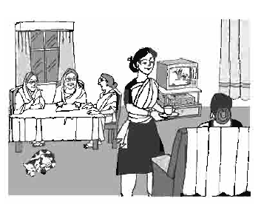
Look at the picture, talk with your partner, who are they and what are they doing?
They are retired women and gossiping among themselves.
Notes:
Showing the picture teacher can ask the question to the whole class. SS will rise their hands. Teacher can ask 5/6 students to narrate the picture.

Slide 5
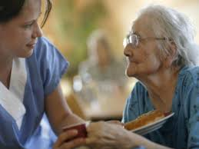
LESSON DECLARATION
An old people’s home

Slide 6
Learning outcomes
After completing this lesson, students will be able to
read and understand texts
infer meaning from context
ask and answer questions
write answers to questions.

Slide 7
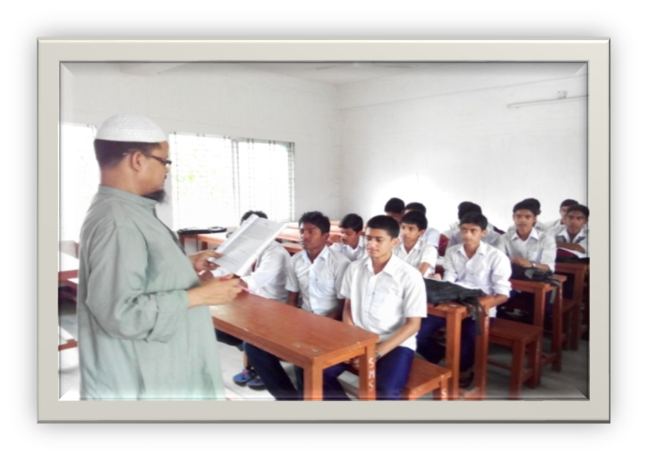
Individual work
Close your book and lesson to me carefully. Now write the following sentences (if they are true or false. If false, then give the right answers).
1. Suraiya Begum spends most her time taking care of her family.
2. She wants to set up a school for adults who cannot read or write.
3. There is already an old people’s home in the town.
4. Mariam enjoys spending time with her aunt.
5. The old people Mariam visits do not like children’s presence.
Notes:
Teacher can play a audio file of CD about this text. Teacher will monitor the class and help the learners if they fail or do wrong.

Slide 8

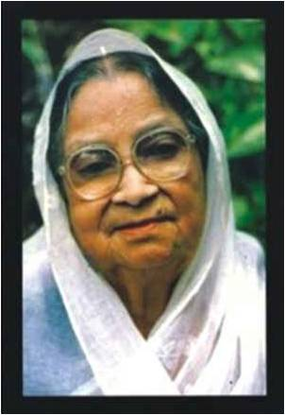
Widow
Key word
Suraiya Begum is a widow.
Meaning
(Click here)
A woman whose husband has died and doesn`t married again.
Notes:
First, the word can be shown. The SS can be asked to pronounce the word. If it is needed teacher can help. Then the picture can be shown and asked to guess the meaning. For feedback click on meaning button.

Slide 9
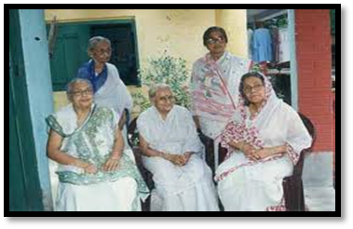
Colleagues
Key word
Try to say the meaning and make sentence about the above word
They are Suriya begum’s colleagues .
Meaning
(Click here)
Coworkers
Notes:
First, the word can be shown. The SS can be asked to pronounce the word. If it is needed teacher can help. Then the picture can be shown and asked to guess the meaning. For feedback click on meaning button.

Slide 10
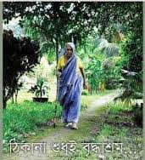
Alone
Key word
Try to say the word meaning and make sentence.
The widow walking alone by the country side.
Meaning
(Click here)
Isolated / Lonely
Notes:
First, the word can be shown. The SS can be asked to pronounce the word. If it is needed teacher can help. Then the picture can be shown and asked to guess the meaning. For feedback click on meaning button.

Slide 11
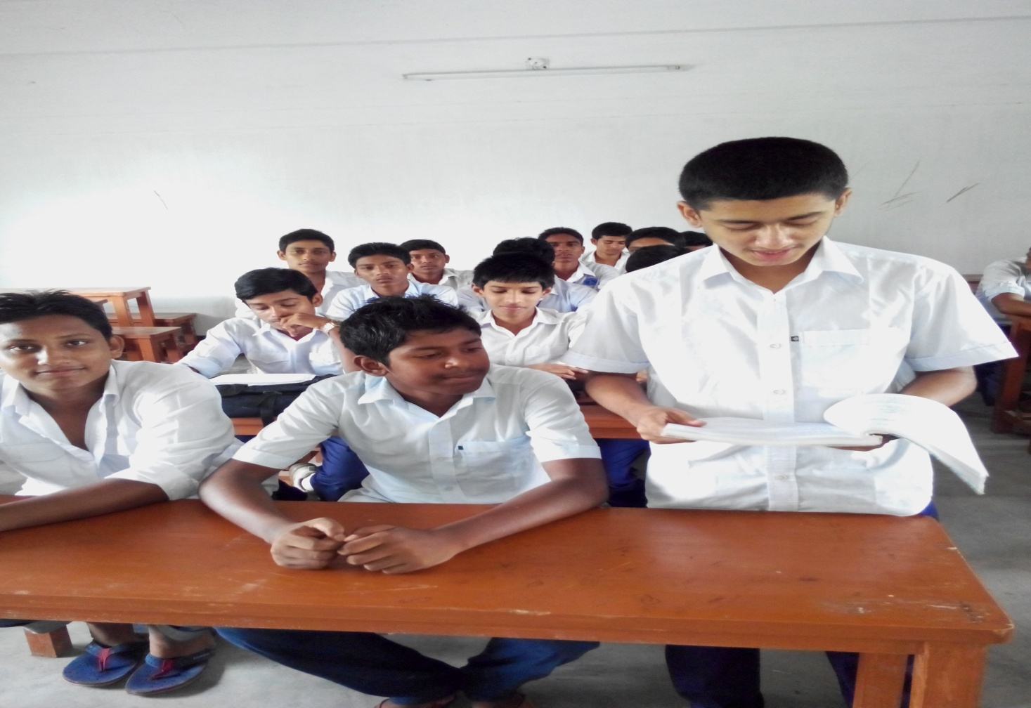
Loud reading
Notes:
Teacher can give feedback.

Slide 12
Pair works
Try to match the words on the left with the words on the right that have similar meanings.
Firm | Set up
Fond of | Withdrawn from service.
Retired | A mercantile house.
Establish | Distress / Pain
Sufferings | Like.
Now go to section –A1 and try to do so.
Notes:
Teacher can use blackboard for this slide. Students will come to blackboard and draw the arrow for answer.

Slide 13
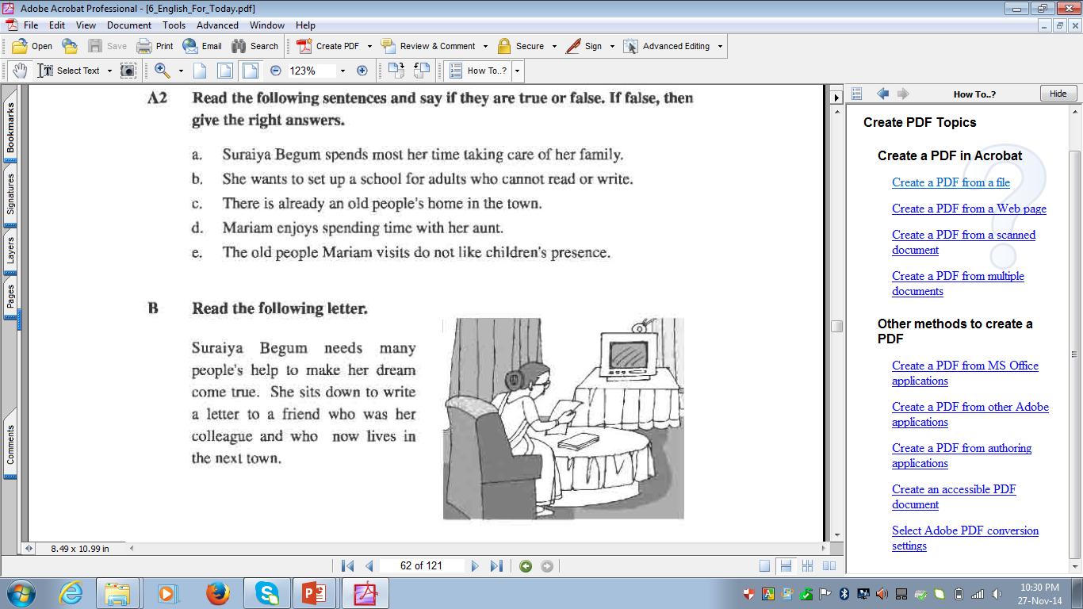
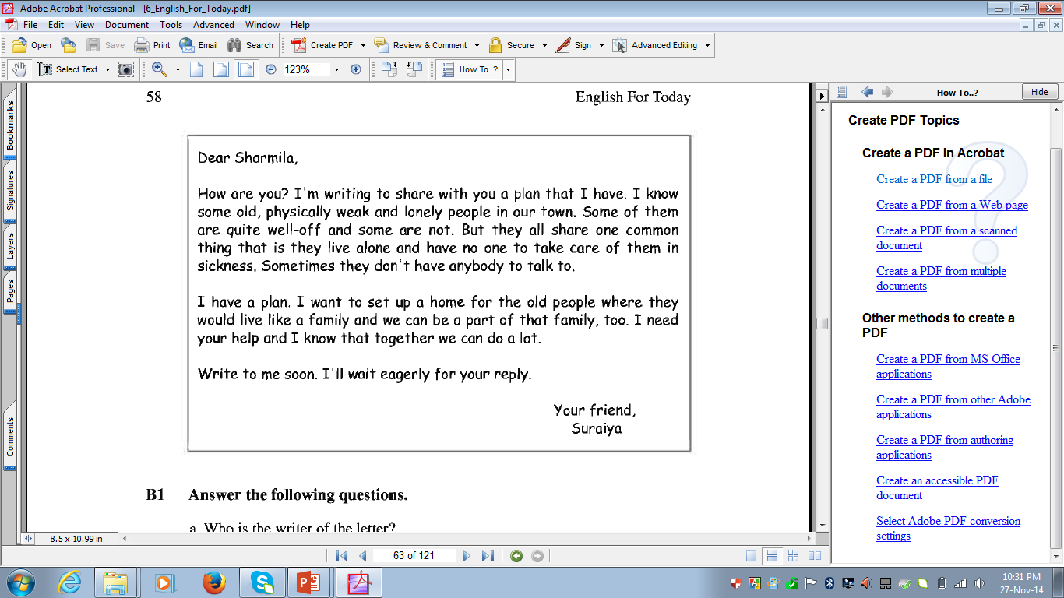
Group/Pair works
Go to section B and read the following letter then answer the following questions.
Who is the writer of this letter?
Who is she writing to? What is the relationship between the two?
Does the writer have any particular reason for writing this letter?
Notes:
At first teacher will divided whole class into groups or pairs then they will ask and answer the questions.

Slide 14

HOME WORK
Think and write about a good work that you can do for someone around you.

Slide 15
Acknowledgement
We would like to express our cordial gratitude to the Ministry of Education, Directorate of Secondary & Higher Education, NCTB, a2i
and
the panel of honorable editors ( Md. Jahangir Hasan, Associate Professor (English) TTC, Rangpur, Ranjit Poddar, Associate Professor (English) TTC, Dhaka, and Urmila Ahmed, Associate Professor (English) TTC, Dhaka, to enrich the contents.

Slide 16
THE END

